Slide 1
Project Description:
Overview: The project aims to analyze user behavior and engagement on a social media platform similar to Instagram.
The insights will support the marketing team in refining their campaigns and help investors understand key user metrics.
Objectives: Identify the most loyal and inactive users. - Determine the user with the most liked photo.
Discover popular hashtags and optimal days for ad campaigns.
Analyze user engagement through post frequency and detect potential bot activity.

Slide 2
Approach
Step 1: Database Creation: Created the ig_clone database using MySQL Workbench. - Set up tables for users, photos, comments, likes, follows, tags, and photo_tags based on the provided schema.
Step 2: Data Insertion: Inserted user, photo, and relationship data into the respective tables using the provided SQL scripts.
Step 3: SQL Query Execution: Executed SQL queries to perform specific analyses: - Identified the five oldest users on the platform.
Located users who have never posted a photo. - Determined the user with the most liked photo.
Found the top five most commonly used hashtags.
Analyzed the best day of the week for user registrations to plan ad campaigns.
Calculated average posts per user and flagged potential bot accounts.
Step 4: Reporting - Documented the SQL queries and their outputs. - Captured screenshots of query execution and results.
Compiled findings into a structured report.

Slide 3
Tech-Stack
Software: MySQL Workbench: Version used: (mention the specific version you used, e.g., 8.0).
Chosen for its comprehensive database management features and ease of executing SQL queries.
Reasoning: User-Friendly Interface: - MySQL Workbench provides an intuitive GUI for database management, making it easier to visualize and manage the database structure.
Powerful Query Execution: It allows for efficient query execution and result analysis, which is crucial for performing the required tasks in this project.

Slide 4
Insights
Key Findings:
Loyal Users: The five oldest users on the platform were identified, indicating those who have been with the platform the longest.
Inactive Users: A significant number of users were found to have never posted a photo, highlighting potential targets for re-engagement campaigns.
Popular Hashtags: Identified the top five hashtags, which can be used to maximize reach in future posts or collaborations.
Optimal Ad Timing: Analysis revealed the day of the week with the highest user registrations, suggesting the best time to launch marketing campaigns.
Additional Insights: User Engagement: The average number of posts per user was calculated, providing a metric for user activity on the platform.
Bot Detection: No users were found who liked every single photo, which suggests that the platform may not have a significant bot issue based on this criterion

Slide 5
Result
Achievements: Successfully created and managed a relational database simulating a social media platform.- Extracted actionable insights using SQL, which can be directly applied to improve marketing strategies and provide investor reports.
Impact:
For Marketing: - The insights allow for targeted re-engagement of inactive users, informed hashtag usage, and optimized timing for ad campaigns.
For Investors: The project provides clear metrics on user engagement and activity, offering reassurance on the platform’s user base quality.

Slide 6
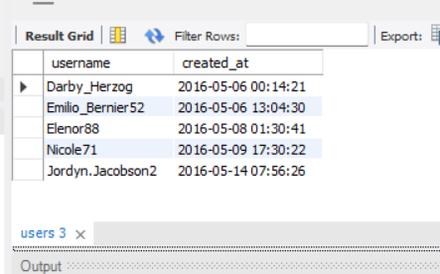
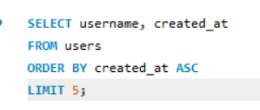
SQL Tasks :
A) Marketing Analysis:
Loyal User Reward: The marketing team wants to reward the most loyal users, i.e., those who have been using the platform for the longest time. Your Task: Identify the five oldest users on Instagram from the provided database.

Slide 7
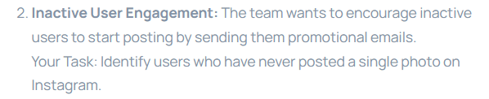
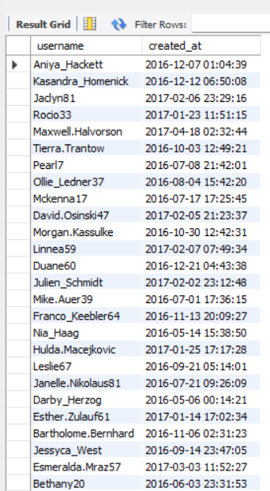
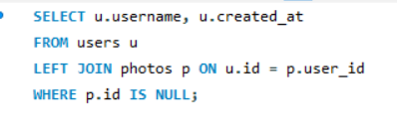

Slide 8
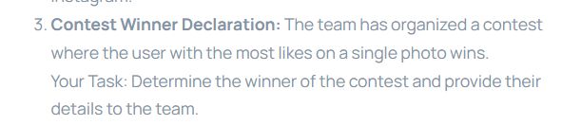
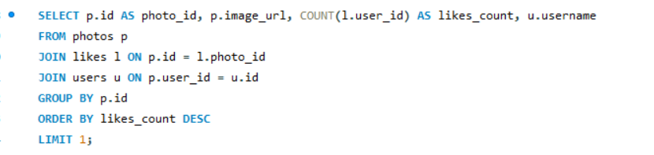
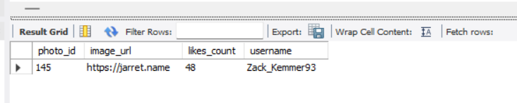

Slide 9
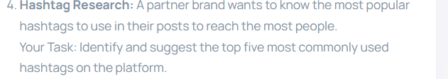
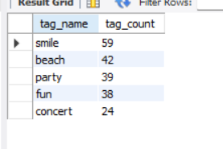
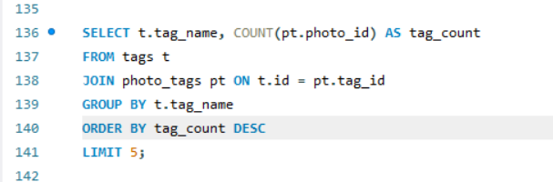

Slide 10
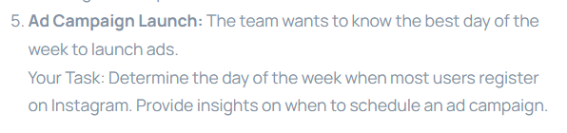
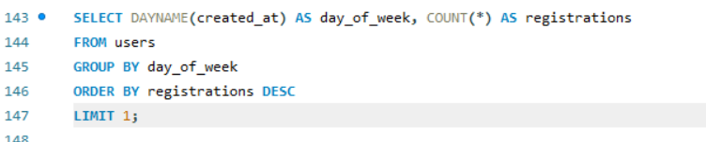
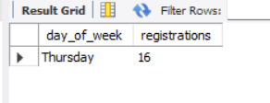

Slide 11
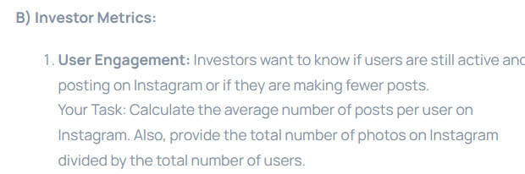
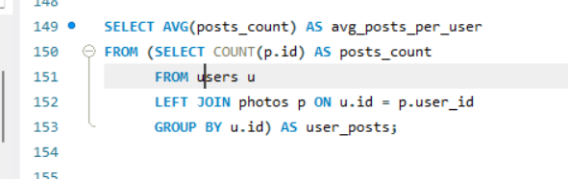
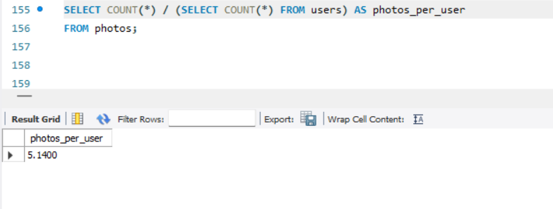
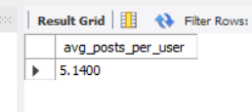

Slide 12
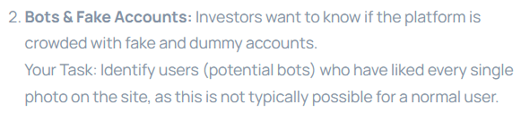
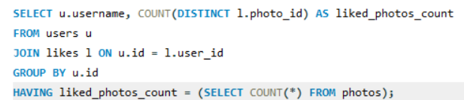


Slide 13
Thank You !

